Slide 1
Week 2 RDBMS Design

Slide 2
Conceptual Data Modeling

Slide 3
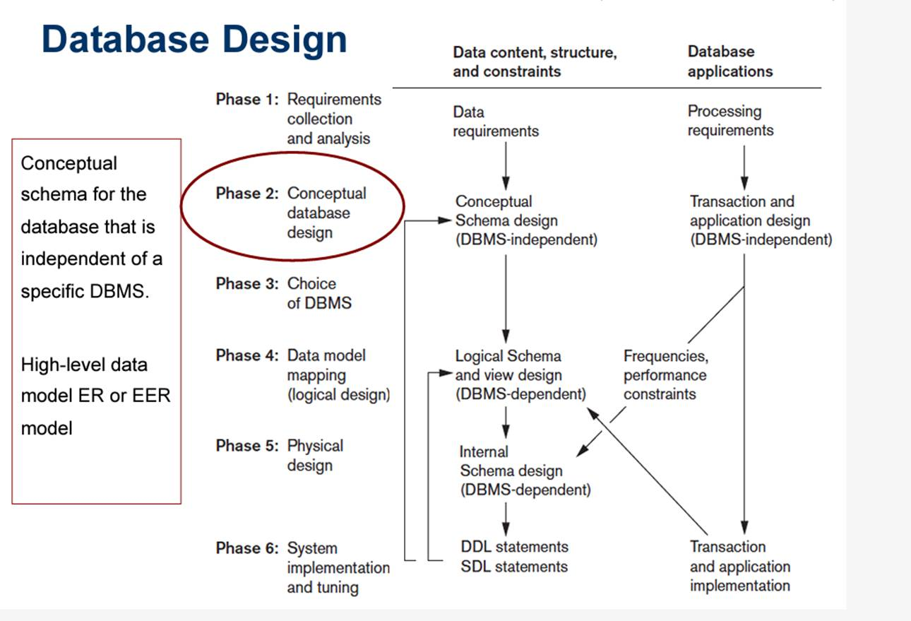

Slide 4
Using High Level Conceptual Data Models
Requirements Gathering (SRS)
Data Requirements
Conceptual Design
Logical Design
Physical Design
Functional Requirements
Functional Analysis
App Design
Transaction Implementation
Why is this important?
If the data engineering team does not capture the requirements and create a high level design, then they could build a DMBS that does not fully meet the requirements. This can create a very negative feedback loop with the business and extend the development of the DBMS due to a misunderstanding of the initial requirements.

Slide 5
Entity Types, Entity Sets, Attributes, and Keys

Slide 6
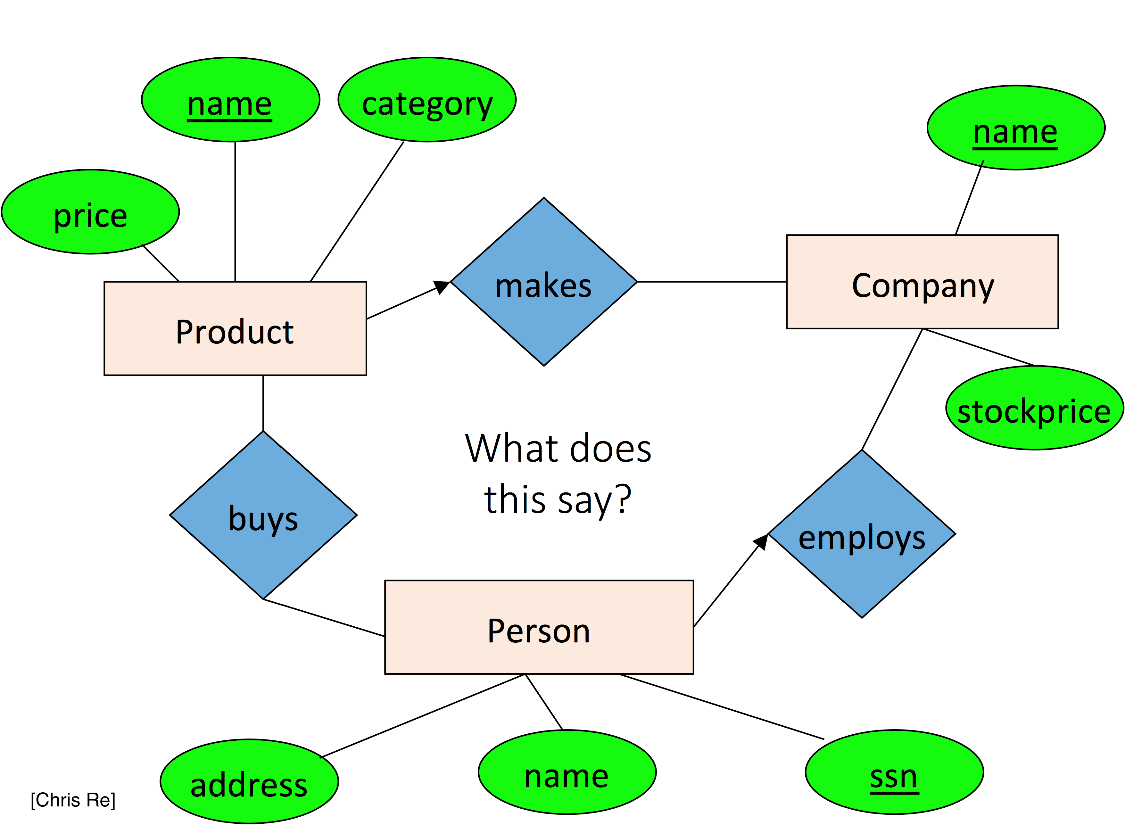
Entities and Attributes
Entities
These are the ‘things’
Often represented as tables/views
Attributes
These are the characteristics of entities
Most notably the columns/features and their data type
Cardinality
Represents the number of instances of an entity that exist in a relationship between two entities
ER Diagrams
Describe the relationships and attributes between entities

Slide 7
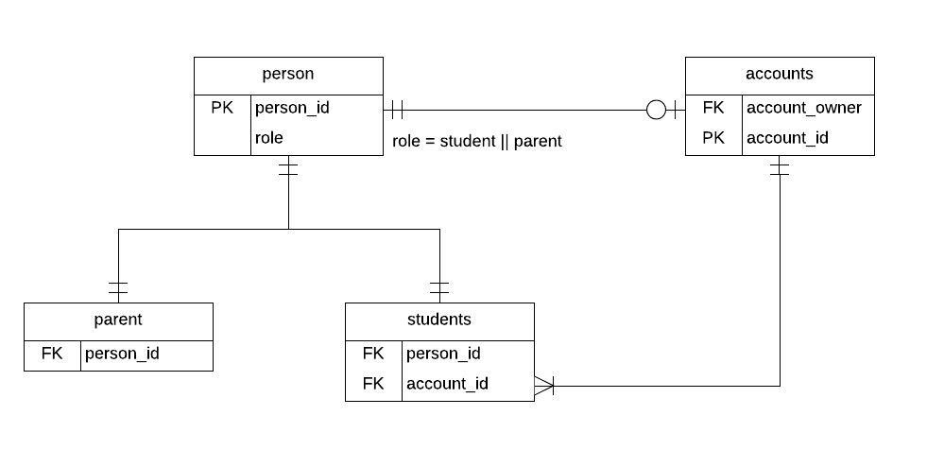
Keys & Uniqueness
ERDs describe relationships between tables
Through the normalization process uniqueness in attributes occur
Tables typically have a Primary Key (PK) – these must be unique
Tables may have Foreign Keys (FK)

Slide 8
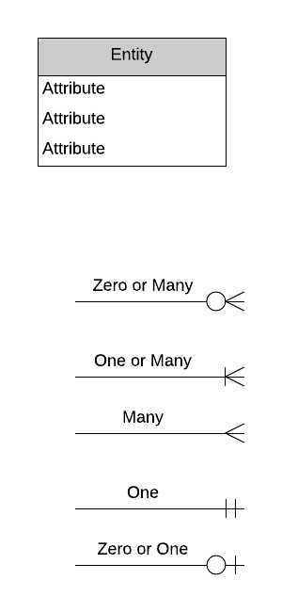
Crows Foot Notation
Reading: Crow's Foot Notation – Relationship Symbols And How to Read Diagrams
Here we are blending logical and physical model concepts
Conceptual model is often done with flow charts
Not only does it provide the entity relationships as described in the book, but it also provides the cardinality in those relationships
Cardinality in the conceptual design can be useful for determining HOW and WHAT technologies or methodologies will be used in the physical design of the DB

Slide 9
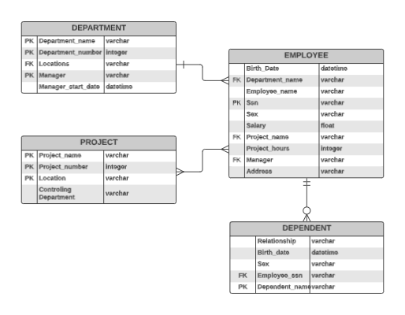
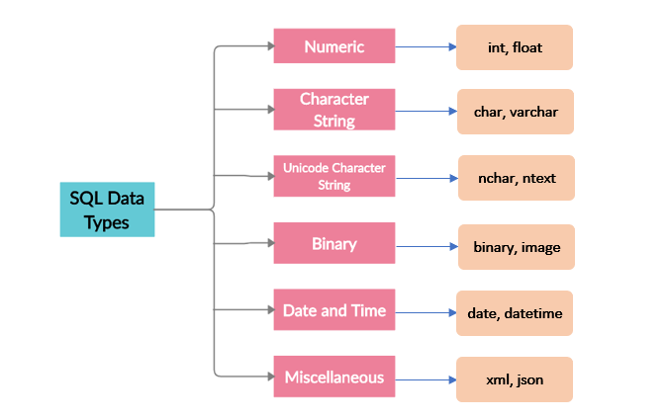
Crows Foot ERD – Figure 3.8

Slide 10
Tools For Diagramming
Luicidchart.com
Microsoft Visio
cloud.smartdraw.com
Creately.com

Slide 11
Relational Concepts

Slide 12
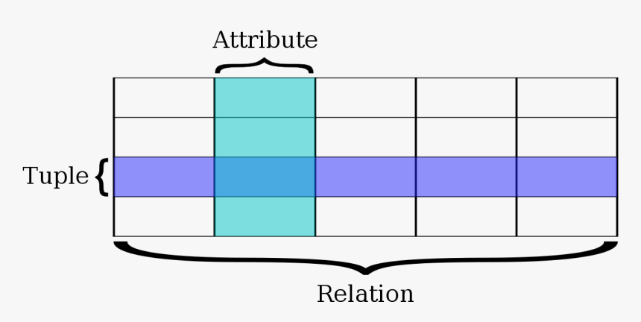
Domain, Attributes, Tuples, and Relations
Domains
Can be thought of as a set of values
Has the same data type and constraints
Attribute
Simply the name of a column
Relation
Describes the attributes that form a table
Ex: Two tables with the same attributes can be UNIONed together
Tuple
An ordered list of n values (a row)

Slide 13
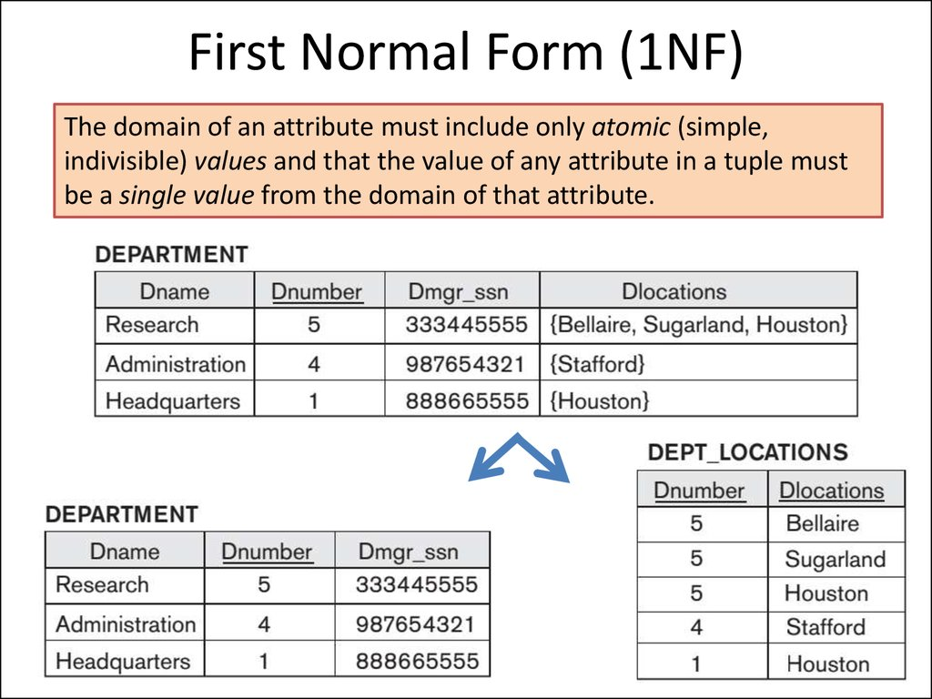
Domain, Attributes, Tuples, and Relations
Self-describing-data
Think of these tuples as key-value pair data where the key is the attribute
JSON, XML, etc
Flat relational model
Composite/multivalued attributes are not allowed (No JSON nesting)
Here we mean STRUCTURED data or First Normal Form

Slide 14
Relational Data Model Constraints & Relational Database Schemas

Slide 15
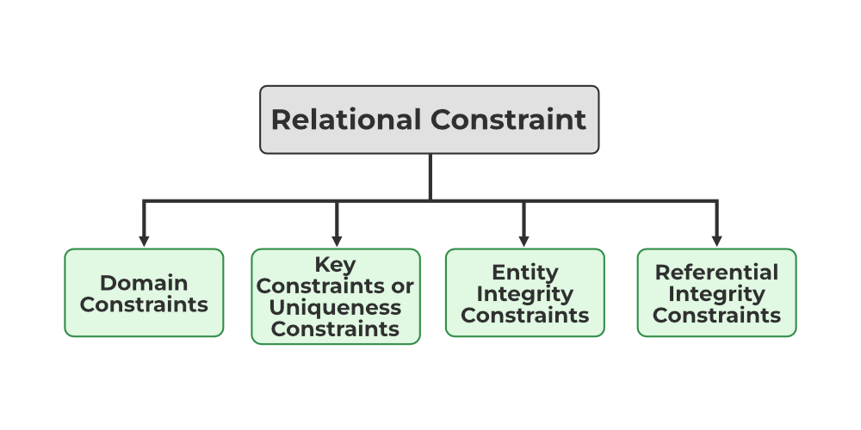
Constraints
Inherent Constraints
Constraints described in the logical/conceptual data model
Explicit Constraints
Described by the physical data model expressed within the DDLs
Semantic Constraints
Expressed within the application layer outside of the DB itself
Domain Constraints
Every domain must contain atomic values
Data types
Key Constraints
Every tuple in the relation should be unique
Entity Integrity Constraints
PKs cannot contain NULLs
Referential Integrity Constraints
Specified between two relations or tables and used to maintain the consistency among the tuples in two relations
Relational Constraints
Imposed on the table contents

Slide 16
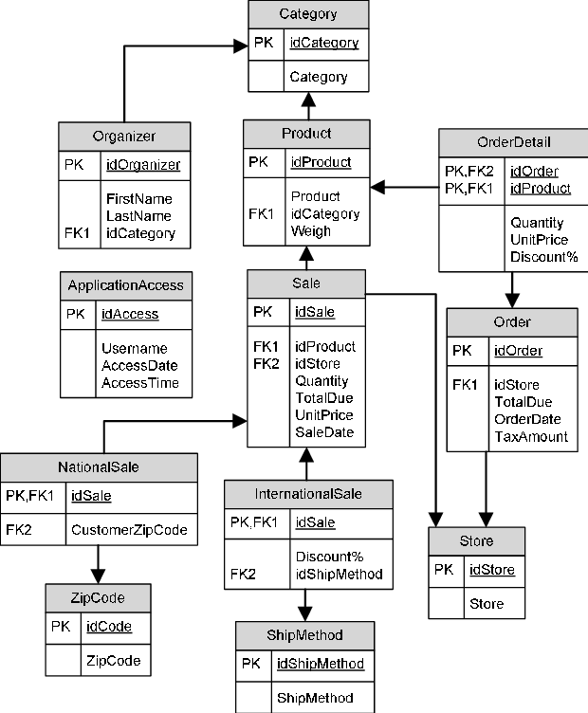
Relational Databases and Relational Database Schemas
Relational Database Schema
A set of relation schemas (tables)
Primary Key
Ensures that data in the specific attribute is unique
Foreign Key
Attribute or group of attributes in a relation that provides a link between data in two relations

Slide 17
Constraint Violations

Slide 18
Insert, Delete, Update Violations
Insert
Inserts a list of attributes as a new tuple (inserts a row)
Domain: A new attribute is inserted
Key: The value already exists in the key attribute
Integrity: Any part of the primary key is NULL
Referential: Any foreign key does not exist in any referenced relation
Delete
Referential: Any foreign keys from another relation reference the tuple being deleted
Reject – reject the deletion
Cascade – delete any associated tuples that reference the tuple
Update
No major constraint violations
Updating a primary key is equivalent to deleting and inserting a new tuple

